Slide 1
Mobile Network Layer

Slide 2
Tunneling and Encapsulation
Mechanism for forwarding packets between the HA and the COA
A tunnel establishes a virtual pipe for data packets between a tunnel entry and a tunnel endpoint.
Tunneling, i.e., sending a packet through a tunnel, is achieved by using encapsulation.
Encapsulation is the mechanism of taking a packet consisting of packet header and data and putting it into the data part of a new packet.
The reverse operation, taking a packet out of the data part of another packet, is called decapsulation.

Slide 3
Tunneling and encapsulation
Encapsulation and decapsulation are the operations typically performed when a packet is transferred from a higher protocol layer to a lower layer or from a lower to a higher layer respectively.
Here these functions are used within the same layer.

Slide 4
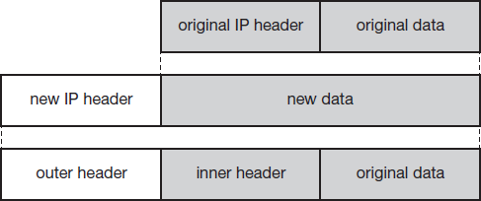
Tunneling and encapsulation
The HA takes the original packet with the MN as destination, puts it into the data part of a new packet and sets the new IP header in such a way that the packet is routed to the COA.
The new header is also called the outer header for obvious reasons.
IP Encapsulation
Additionally, there is an inner header which can be identical to the original header as this is the case for IP-in-IP encapsulation, or the inner header can be computed during encapsulation.

Slide 5
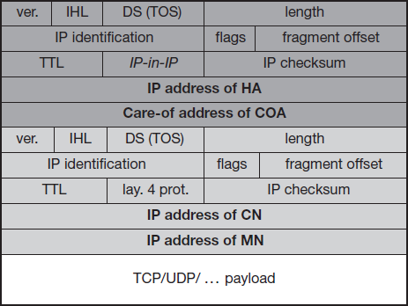
IP-in-IP encapsulation
different ways of performing the encapsulation
Mandatory for mobile IP is IP-in-IP encapsulation.
The fields follow the standard specification of the IP protocol and the new interpretation of the former TOS, now DS field in the context of differentiated services.
ver is 4 for IP version 4
Internet header length
(IHL)
denotes the length of the outer
header in 32 bit words.
DS(TOS) is just copied
from the
inner header
the length field covers the complete encapsulated packet.
IP-in-IP Encapsulation

Slide 6
IP-in-IP encapsulation
The fields up to TTL have no special meaning for mobile IP.
TTL must be high enough so the packet can reach the tunnel endpoint.
IP-in-IP, is the type of the protocol used in the IP payload.
This field is set to 4, the protocol type for IPv4 because again an IPv4 packet follows after this outer header.
IP checksum is calculated as usual.
The tunnel entry as source address (the IP address of the HA) and the tunnel exit point as destination address (the COA).

Slide 7
IP-in-IP encapsulation
If no options follow the outer header, the inner header starts with the same fields.
This header remains almost unchanged during encapsulation, thus showing the original sender CN and the receiver MN of the packet.
The only change is TTL which is decremented by 1.
This means that the whole tunnel is considered a single hop from the original packet’s point of view.
It allows the MN to behave as if it were attached to the home network.
No matter how many real hops the packet has to take in the tunnel, it is just one (logical) hop away for the MN.
Finally, the payload follows the two headers.

Slide 8
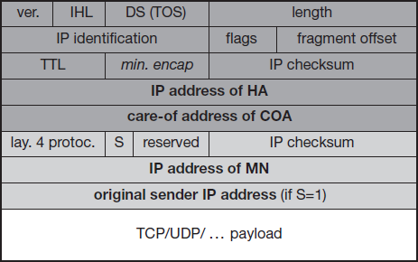
Minimal encapsulation
It is an optional encapsulation method for mobile IP.
The tunnel entry point and endpoint are specified.
the value 55 for the minimal encapsulation protocol.
The inner header is
different for
minimal encapsulation.
The type of the following protocol and the address of the MN are needed.
If the S bit is set, the original sender address of the CN is included.
No field for fragmentation offset is left in the inner header and minimal encapsulation does not work with already fragmented packets.
Minimal Encapsulation

Slide 9
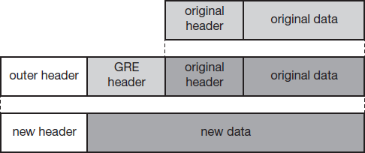
Generic routing encapsulation
This encapsulation scheme also supports other network layer protocols in addition to IP.
GRE allows the encapsulation of packets of one protocol suite into the payload portion of a packet of another protocol suite.
The packet of one protocol suite with the original packet header and data is taken and a new GRE header is prepended.
Together this forms the new data part of the new packet. Finally,
Generic Routing Encapsulation
the header of the second protocol suite is put in front.

Slide 10
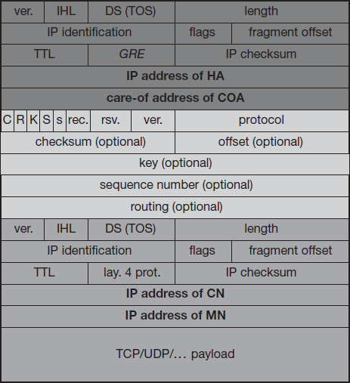
Generic routing encapsulation
The outer header is the standard IP header with HA as source address and COA as destination address.
The protocol type used in this outer IP header is 47 for GRE.
The other fields of the outer packet, such as TTL and TOS, may be copied from the original IP header. However, the TTL must be decremented by 1 when the
packet is prevent forwarding.
decapsulated to
indefinite

Slide 11
Generic routing encapsulation
The GRE header starts with several flags
A minimal GRE header uses only 4 bytes;
The C bit indicates if the checksum field is present and contains valid information.
If C is set, the checksum field contains a valid IP checksum of the GRE header and the payload.
The R bit indicates if the offset and routing fields are present and contain valid information.
The offset represents the offset in bytes for the first source
routing entry.
The routing field, if present, has a variable length and contains fields for source routing.
If the C bit is set, the offset field is also present and, vice versa, if the R bit is set, the checksum field must be present.
The only reason for this is to align the following fields to 4 bytes.

Slide 12
Generic routing encapsulation
GRE also offers a key field which may be used for authentication.
The K bit is set. However, the authentication algorithms are not further specified by GRE.
The sequence number bit S indicates that the sequence number field is present.
Sequence numbers may be used by a decapsulator to restore packet order.
Now the decapsulator at the tunnel exit must restore the sequence to maintain the characteristic of the protocol.
if the s bit is set, strict source routing is used.

Slide 13

Generic routing encapsulation
The recursion control field (rec.) represents a counter that shows the number of allowed recursive encapsulations. As soon as a packet arrives at an encapsulator it checks whether this field equals zero.
If the field is not zero, additional encapsulation is allowed – the packet is encapsulated and the field decremented by one. Otherwise the packet will most likely be discarded.
This mechanism prevents indefinite recursive encapsulation which might happen with the other schemes if tunnels are set up improperly (e.g., several tunnels forming a loop).
The default value of this field should be 0, thus allowing only one level of encapsulation.

Slide 14
Generic routing encapsulation
The following reserved fields must be zero and are ignored on reception. The version field contains 0 for the GRE version.
The following 2 byte protocol field represents the protocol of the packet following the GRE header.
In the case of a mobile IP tunnel, the protocol field contains 0×800 for IP. The standard header of the original packet follows with the source address of the correspondent node and the destination address of the mobile node.
The field C indicates again if a checksum is present. The next 5 bits are set to zero, then 7 reserved bits follow.

Slide 15
Generic routing encapsulation
The version field contains the value zero.
The protocol type, again, defines the protocol of the payload. If the flag C is set, then checksum field and a field called reserved1 follows.
The latter field is constant zero set to zero follow.

Slide 16
Optimization
Inefficient behavior of a non-optimized mobile IP is called triangular routing.
The triangle is made of the three segments, CN to HA, HA to COA/MN, and MN back to CN.
This can cause unnecessary overheads for the network between CN and HA, but also between HA and COA, depending on the current location of the MN.
One way to optimize the route is to inform the CN of the current location of the MN.
The CN can learn the location by caching it in a binding cache which is a part of the local routing table for the CN.
The appropriate entity to inform the CN of the location is the HA.

Slide 17
The optimized mobile IP protocol needs four additional messages.
Binding request
Binding update:
Binding acknowledgement
Binding warning

Slide 18
Binding request
Any node that wants to know the current location of an MN can send a binding request to the HA.
The HA can check if the MN has allowed dissemination of its current location.
If the HA is allowed to reveal the location it sends back a binding update.

Slide 19
Binding update
This message sent by the HA to CNs reveals the current location of an MN.
The message contains the fixed IP address of the MN and the COA.
The binding update can request an acknowledgement.
Binding acknowledgement
If requested, a node returns this acknowledgement after receiving a binding update message.

Slide 20
Binding warning
If a node decapsulates a packet for an MN, but it is not the current FA for this MN, this node sends a binding warning.
The warning contains MN’s home address and CN node address.
The recipient of the warning then knows that the CN node could benefit from obtaining a fresh binding for the MN.
The HA should now send a binding update to the node that obviously has a wrong COA for the MN.

Slide 21
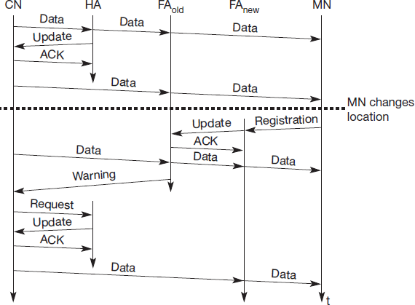
The
CN can request the
current location from the
HA. If allowed by the MN, the HA returns the COA of the MN via an update message.
The CN acknowledges this
update stores binding.
message and
the mobility
Now the CN can send its data directly to the current foreign agent FA_{old}.
FA_{old} forwards the packets
to the MN. This scenario shows a COA located at an FA. Encapsulation of data for tunneling to the COA is now done by the CN, not the HA.
Change of FA with an optimized mobile IP

Slide 22
The MN might now change its location and register with a new foreign agent, FA_{new}.
This registration is also forwarded to the HA to update its location database.
Furthermore, FA_{new} informs FA_{old} about the new registration of MN.
MN’s registration message contains the address of FA_{old} for this purpose.
Passing this information is achieved via an update message, which is acknowledged by FA_{old}.

Slide 23
Without the information provided by the new FA, the old FA would not get to know anything about the new location of MN.
In this case, CN does not know anything about the new location, so it still tunnels its packets for MN to the old FA, FAold.
This FA now notices packets with destination MN, but also knows that it is not the current FA of MN.
FA_{old} might now forward these packets to the new COA of MN which is FA_{new} in this example.
This forwarding of packets is another optimization of the basic Mobile IP providing smooth handovers.
Without this optimization, all packets in transit would be lost while the MN moves from one FA to another.
With TCP as the higher layer protocol this would result in severe performance degradation.

Slide 24
To tell CN that it has a stale binding cache, FA_{old} sends, a binding warning message to CN.
CN then requests a binding update. (The warning could also be directly sent to the HA triggering an update).
The HA sends an update to inform the CN about the new location, which is acknowledged.
Now CN can send its packets directly to FA_{new}, again avoiding triangular routing.
Unfortunately, this optimization of mobile IP to avoid triangular routing causes several security problems (e.g., tunnel hijacking).
Not all users of mobile communication systems want to reveal their current location (in the sense of an IP subnet) to a communication partner.

